Slide 1
Chapter 2
Biology, Prenatal Development, and Birth
Notes:
Add slide notes here

Slide 2
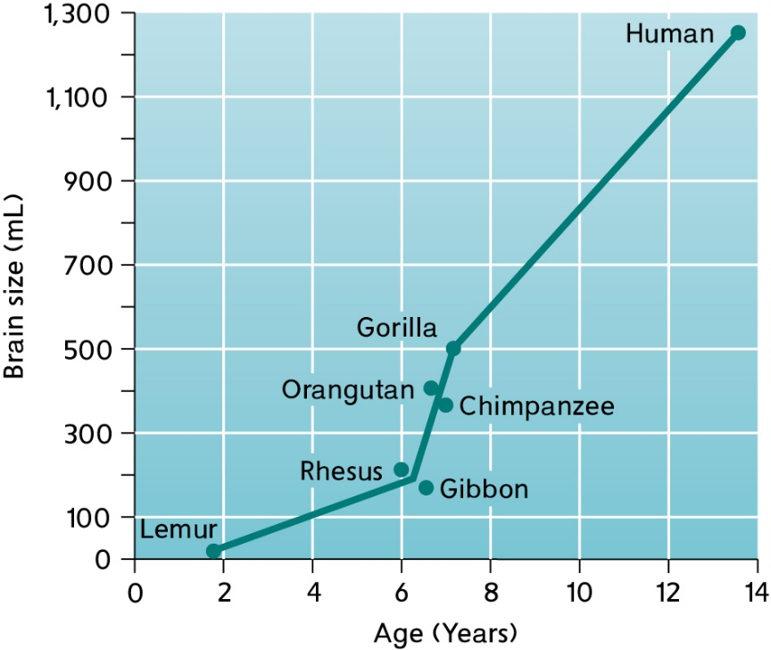
Why is having a larger brain advantageous?
Potential problems with lengthy development?

Slide 3
Natural Selection and Adaptive Behavior
Natural selection: individuals of a species that are best adapted are the ones that survive and reproduce
Adaptive behavior: promotes an organism’s survival in the natural habitat
  More likely to be passed on to offspring

Slide 4
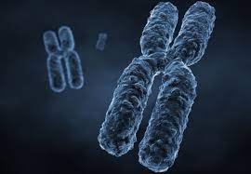
Genetic Foundations of Development
How are traits passed from parents to offspring?
Genetic material
  Chromosomes!
  Genes!
  DNA!

Slide 5
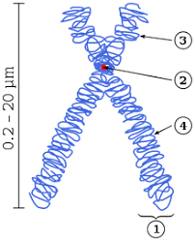
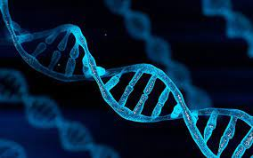
Chromosomes and DNA
Human life begins as a single cell (Zygote).
Nucleus of this cell contains chromosomes
  Chromosomes: threadlike structures made up of deoxyribonucleic acid (DNA).
    DNA: complex double-helix molecule that contains genetic code or information
  All cells have 46 chromosomes EXCEPT sex chromosomes (23)

Slide 6

Genes
Gene: a group of compounds that provides a specific set of biochemical instructions
  Stored inside chromosomes
  Instruction code for a single molecule within the body
  Genes are specific segments of DNA (located on chromosomes)!

Slide 7
The Genetic Code
Conception—when an egg (ova) is fertilized by a sperm
Sperm cell and egg cells each contribute 23 chromosomes to the zygote (46 total):
  Zygote = fertilized egg cell = 46 chromosomes total
    23 from egg cell, 23 from sperm cell
Notes:
Figure 3.1

Slide 8
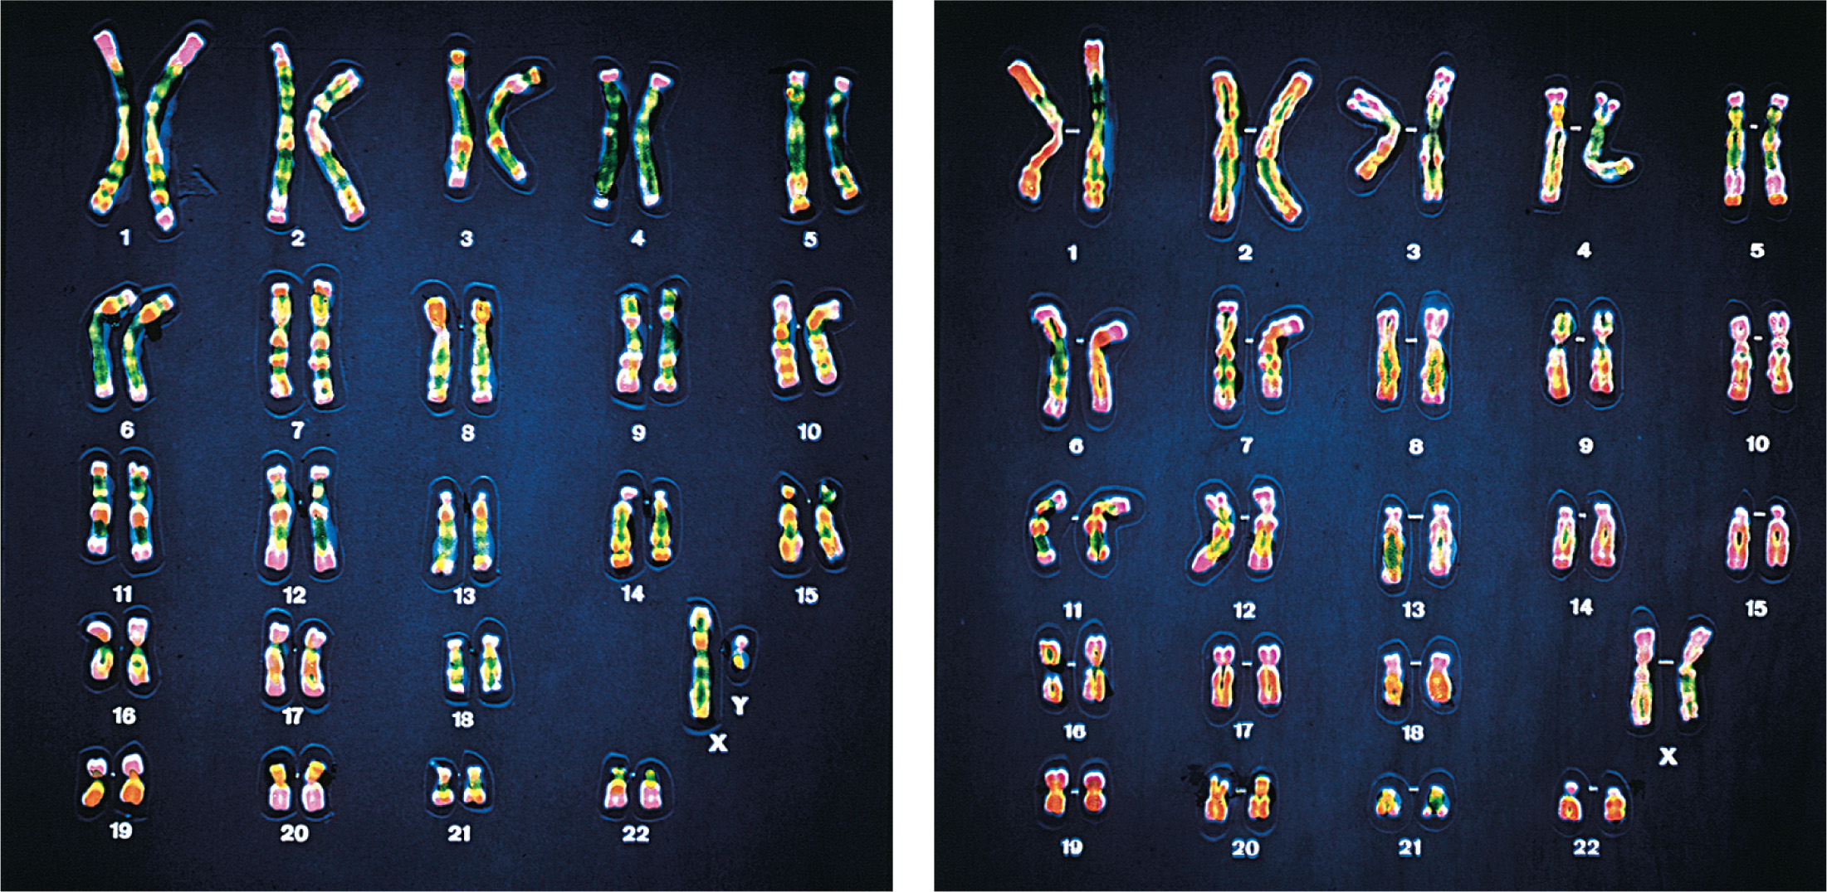
Determination of Sex
Chromosomes of the 23rd pair are the sex chromosomes:
  Male—one X chromosome and one Y chromosome
  Female—two X chromosomes
Father determines child’s sex!

Slide 9
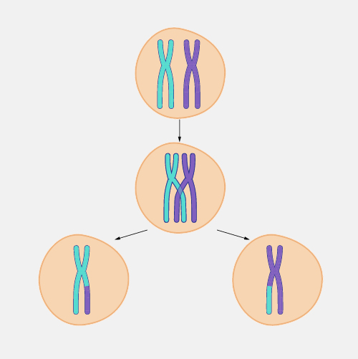
Why are we genetically unique?
Crossing over
  To form sex cells: pairs of chromosomes line up, and before separating, they cross each other and parts are exchanged.
  Unlikely that there will be another human exactly like you genetically
    Exception of identical twins!
Identical twins:
  One fertilized ovum divides to form two or more genetically identical individuals.
Fraternal twins:
  Two ova are released at approximately the same time and each is fertilized by a different sperm.

Slide 10
Genotype vs Phenotype
Genotype:
  Genetic makeup a person inherits (underlying code or blueprints)
Phenotype:
  The characteristic or trait the person eventually has (actual expressed trait)
Gene expression:
  Activation of particular genes in particular cells of the body at particular times

Slide 11
Mechanisms of Inheritance (1 of 2)
Single gene-pair inheritance:
  Thousands of human characteristics are influenced by only one pair of genes.
    One from the mother; one from the father
Dominant gene:
  A gene that will be expressed when paired with a recessive gene
Recessive gene:
  A weaker gene (trait needs two recessives to be expressed)

Slide 12
Dominant Trait | Recessive Trait
Brown eyes | Gray green, hazel, or blue eyes
Dark hair | Blond hair
Nonred hair | Red hair
Curly hair | Straight hair
Normal vision | Nearsightedness
Farsightedness | Normal vision
Broad lips | Thin lips
Double jointed | Normal joints
Pigmented skin | Albinism
Type A blood | Type O blood
Type B blood | Type O blood
Notes:
Table 3.2

Slide 13
Mechanisms of Inheritance (2 of 2)
Sex-linked characteristics:
  Influenced by single genes located on the sex chromosomes
  Most of these attributes are associated with genes located on X chromosomes.
    Example: Hemophilia is a deficiency in the blood’s ability to clot.
Polygenic inheritance:
  Influenced by multiple pairs of genes, interacting with multiple environmental factors
  Examples: height, weight, intelligence

Slide 14
Mutations and Copy Number Variations (1 of 2)
Mutations:
  A change in the structure or arrangement of one or more genes that produces a new phenotype
  Odds that mutations will occur are increased by environmental hazards
  Most are just spontaneous errors during cell division.

Slide 15
Chromosome Abnormalities
Chromosomal abnormalities:
  Result when a child receives too many, too few, or abnormal chromosomes
  Most caused by errors in chromosome division during meiosis
  Main cause of pregnancy loss
Down syndrome (trisomy 21): It is associated with three 21st chromosomes.
Turner syndrome: Female is born with a single X chromosome.
Klinefelter syndrome: Male born with one or more extra X chromosomes.

Slide 16
Studying Genetic and Environmental Influences
Behavioral genetics:
  Scientific study of the extent to which genetic and environmental differences among people are responsible for differences
Heritability:
  Proportion of all the variability in the trait within a large sample of people that can be linked to genetic differences among those individuals

Slide 17
Twin and Adoption Studies (1 of 2)
Adoption studies:
  Are children adopted early in life psychologically similar to their biological parents or their adoptive parents?
  Problems?
    The prenatal environment the biological mother provided could influence development.
    May underestimate the effects of the full range of environments children can experience

Slide 18
Twin and Adoption Studies (2 of 2)
Twin studies:
  Determine whether identical twins reared together are more similar to each other than fraternal twins reared together.
  Limitations
    Do findings generalize to single children?
    Identical twins could be more psychologically similar because they shared prenatal environment.
    Identical twins are often treated more similarly, which could explain their psychological similarity.

Slide 19
Twin Studies
What about identical twins separated at birth?
Example: The “Jim Twins”
Jim Lewis and Jim Springer: Identical Twins separated at birth who led remarkable similar lives

Slide 20
Twin Studies
James ‘Jim’ Lewis, of Lima Ohio, was adopted in 1940 just three weeks after he was born. He was named James by his adoptive parents, and had a dog named Toy. As a schoolboy, he enjoyed math and carpentry but never spelling. He went on to marry a woman named Linda. Later, he and Linda divorced, and he married a woman named Betty. He had a son named James Alan Lewis, worked as a security guard, drove a Chevrolet, and was an avid chain smoker.

Slide 21
Twin Studies
James ‘Jim’ Springer, of Piqua Ohio, was adopted in 1940 just three weeks after he was born. He was named James by his adoptive parents and had a dog named Toy. As a schoolboy, he enjoyed math and carpentry but never spelling. He went on to marry a woman named Linda. Later, he and Linda divorced, and he married a woman named Betty. He had a son named James Allan Springer, worked as a deputy sheriff, drove a Chevrolet, and was an avid chain smoker.

Slide 22
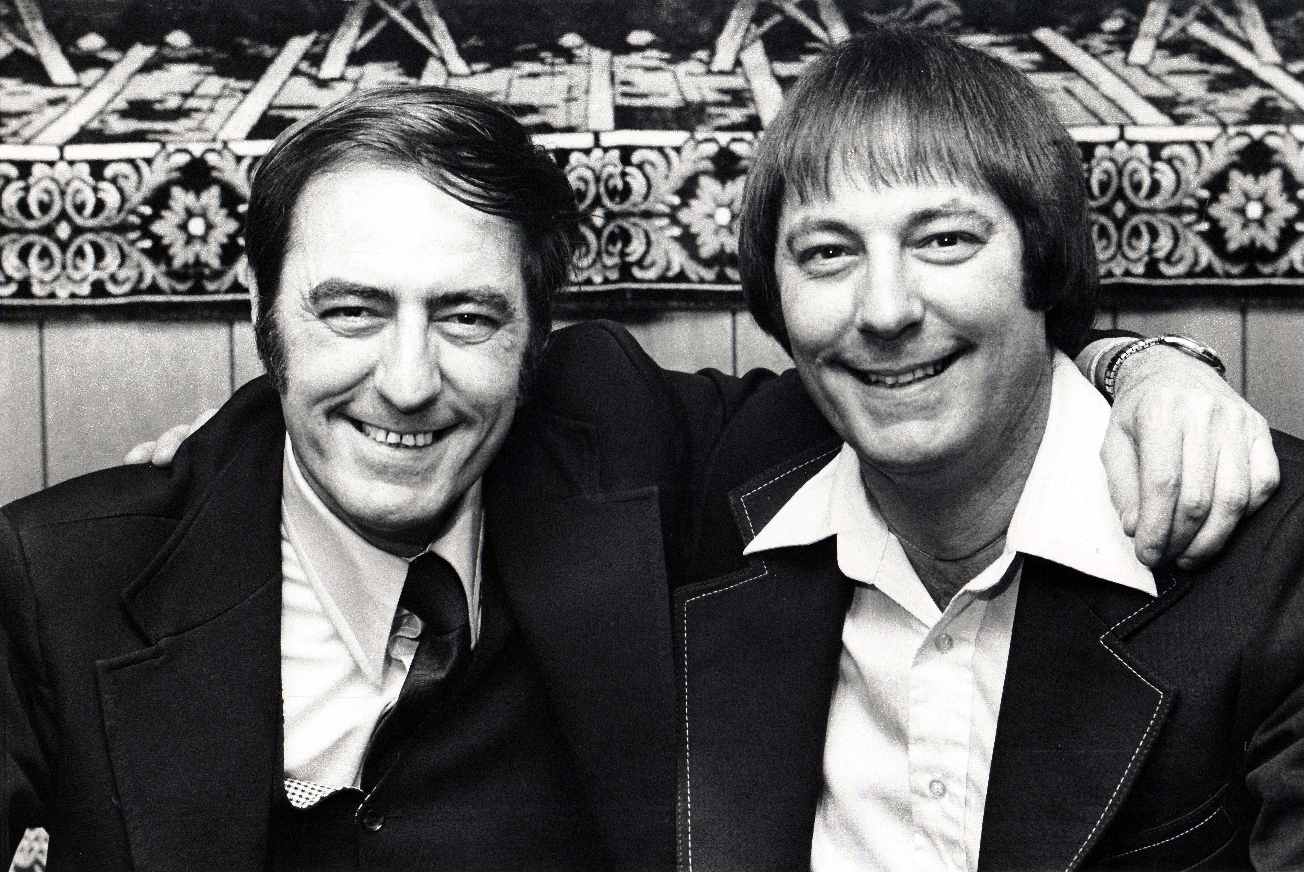

Slide 23
Similarities?
Same name for childhood dogs
Liked the same subjects in school
Married women with the same names
Gave their sons similar names
Drove the same type of car
Similar careers
Both chain smokers
Are these similarities due to genetics? Why or why not?

Slide 24
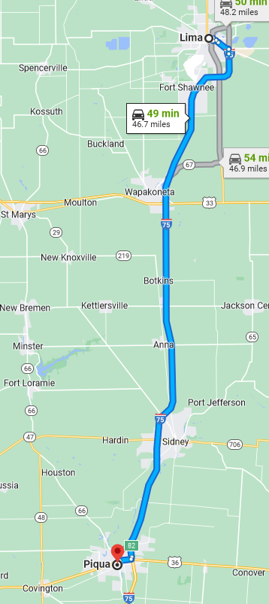
What about Twins in Different Environments?
The Jims both grew up in Ohio (50 miles apart)
Similar outcome because same culture?
Identical twins raised in two different countries?

Slide 25
What about Twins Raised in Different Environments?
Identical twins born in Seoul, South Korea (1974)
Separated at the age of two (lost in a market)
One girl reunited w/ family; other adopted by a family in the US
Reunited in 2018 (44 years old)
Notes:
What’s the difference?
Collectivist == emphasizes how the self-relates to others (place w/in society)
Individualist == individual freedoms are most important

Slide 26
What about Twins Raised in Different Environments?
Environmental Differences:
  Individualistic vs. Collectivist
  US Family was stricter and more religious than South Korean Family
Notes:
What’s the difference?
Collectivist == emphasizes how the self-relates to others (place w/in society)
Individualist == individual freedoms are most important

Slide 27
What about Twins Raised in Different Environments?
Outcomes:
  Similar:
    Medical Histories
    Mental Health
    Personalities
  But differences in IQ (US twin was 16 points lower)

Slide 28
Temperament and Personality
Temperament:
  Tendencies to respond in predictable ways, such as sociability and emotional reactivity, that serve as the building blocks of later personality
  Findings indicate that living in the same home does not make children more similar in personality.

Slide 29
Epigenetic Effects on Gene Expression
Epigenetic effects:
  Environmental factors affect whether or not particular genes in particular cells are expressed.
  Might explain differences in identical twins

Slide 30
Periods of Prenatal Development
Prenatal development takes an average of 38 weeks
  Time measured from date of conception
  Usually occurs about two weeks after woman’s last menstrual period

Slide 31
Stages of Prenatal Development
Germinal Period (0 – 2 weeks)
Embryonic Period (3 – 8 Weeks)
Fetal Period (9 weeks to Birth)

Slide 32
What happens after Conception?
Germinal Period (0 to 2 Weeks)
Zygote begins to divide and travel down the fallopian tube
Cell differentiation
Notes:
Learning Objective: 2-4: Summarize three periods of prenatal development and commonly used prenatal diagnostic tests.
Prenatal Development
A. Conception
a. Women can conceive during a short window of time each month when an ovum bursts form one of the ovaries into the fallopian tube (ovulation)
b. Men’s testes produce millions of sperm each day; after entering the vagina, sperm travel through the cervix and uterus to the fallopian tube, where fertilization may occur
B. Germinal Period (0 to 2 Weeks)
a. Germinal period (period of the zygote): the period in which the zygote begins to divide and travel down the fallopian tube
b. Cell differentiation
i. Stem cells
ii. Blastocyst: a fluid-filled sphere with cells forming a protective circle around an inner cluster of cells from which the embryo will develop
iii. Embryo
iv. Implantation: the process in which the blastocyst burrows into the wall of the uterus
h. Placenta

Slide 33
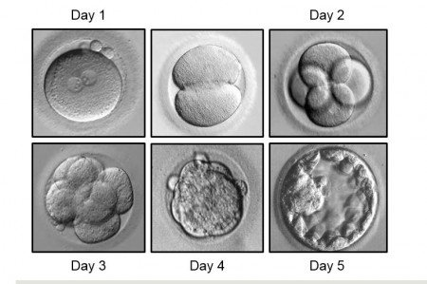
The Zygote – First 5 Days

Slide 34
What happens after Conception?
Germinal Period (0 to 2 Weeks)
Zygote begins to divide and travel down the fallopian tube
Cell differentiation
  Blastocyst: fluid-filled sphere with cells forming protective circle around inner cluster of cells from which embryo will develop
  Implantation: blastocyst burrows into the wall of the uterus
Notes:
Learning Objective: 2-4: Summarize three periods of prenatal development and commonly used prenatal diagnostic tests.
Prenatal Development
A. Conception
a. Women can conceive during a short window of time each month when an ovum bursts form one of the ovaries into the fallopian tube (ovulation)
b. Men’s testes produce millions of sperm each day; after entering the vagina, sperm travel through the cervix and uterus to the fallopian tube, where fertilization may occur
B. Germinal Period (0 to 2 Weeks)
a. Germinal period (period of the zygote): the period in which the zygote begins to divide and travel down the fallopian tube
b. Cell differentiation
i. Stem cells
ii. Blastocyst: a fluid-filled sphere with cells forming a protective circle around an inner cluster of cells from which the embryo will develop
iii. Embryo
iv. Implantation: the process in which the blastocyst burrows into the wall of the uterus
h. Placenta

Slide 35
Prenatal Development
Embryonic Period (3 to 8 Weeks)
Embryo: developing organism
Placenta: principal organ of exchange
Neural tube: structure that will develop into the central nervous system
Notes:
Learning Objective: 2-4: Summarize three periods of prenatal development and commonly used prenatal diagnostic tests.
C . Embryonic Period (3 to 8 Weeks)
a. Embryo: the developing organism that is beginning the most rapid period of structural development in the lifespan
b. Embryonic disk develops into layers
i. Ectoderm—the upper layer, which will become the skin, nails, hair, teeth, sensory organs, and nervous system
ii. Endoderm—the lower layer, which will become the digestive system, liver, lungs, pancreas, salivary glands, and respiratory system
iii. Mesoderm—the middle layer that forms later and will become the muscles, skeleton, circulatory system, and internal organs
c. Amnion: a membrane that holds amniotic fluid, surrounds the embryo, providing temperature regulation, cushioning, and protection from shocks
d. Placenta: a principal organ of exchange between the mother and developing organism
e. Neural tube: created by the folding of the endoderm, the structure that will develop into the central nervous system
f. Indifferent gonad—appears by the end of the eighth week and will develop into male or female genitals
g. At the end of the embryonic period, the embryo weighs about one-seventh of an ounce and is an inch long
h. Spontaneous abortion may happen if serious defects emerge

Slide 36
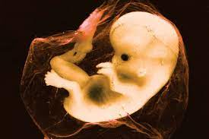
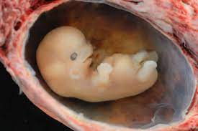
The Embryo
Body structures and internal organs begin to develop during this period

Slide 37
The Embryo
The embryo consists of three unique layers
  Ectoderm (outer layer: becomes hair, skin, nervous system)
  Mesoderm (middle layer: becomes muscles, bones, circulatory system)
  Endoderm (inner layer: becomes digestive system and lungs)

Slide 38
The Embryo
Growth of the embryo follows two important principles:
  the cephalocaudal principle, where the head develops before the rest of the body
  the proximodistal principle, in which growth of parts near the center of the body occurs before those that are more distant.

Slide 39
Prenatal Development
Fetal Period (9 Weeks to Birth)
12th week: upper limbs almost reach final relative length, lower limbs slightly shorter
14th week: coordinated limb movements, stronger heartbeat, structures begin to form
21st week: rapid eye movements, brain begins respond
Week 21-25: body proportions becoming more like a newborn infant
Last 3 months: substantial weight gain and growth, brain development
Notes:
Learning Objective: 2-4: Summarize three periods of prenatal development and commonly used prenatal diagnostic tests.
D. Fetal Period (9 Weeks to Birth)
a. Fetal period: the period from the ninth week to birth in which the organism (fetus) grows rapidly and its organs become more complex and begin to function
b. Fetus: the classification of the growing organism from nine weeks on
c. 12th week: upper limbs almost reach final relative length, lower limbs slightly shorter
d. 14th week: coordinated limb movements (too faint to be felt), stronger heartbeat, eyelids, eyebrows, fingernails, toenails, and tooth buds form
i. Lanugo: a fine down-like hair that covers the fetus’s body that is gradually replaced by human hair
ii. Vernix caseosa: a greasy material that covers the protects the fetal skin from abrasions, chapping, and hardening that can occur with exposure to amniotic fluid
e. 21 weeks: rapid eye movements, brain begins to become responsive
f. weeks 21 to 25: substantial weight gain, body proportions becoming more like a newborn infant
g. Last 3 months: substantial weight gain and growth, further brain development
h. Age of viability: the age at which advanced medical care permits a preterm newborn to survive outside the womb (begins at about 22 weeks after conception)

Slide 40
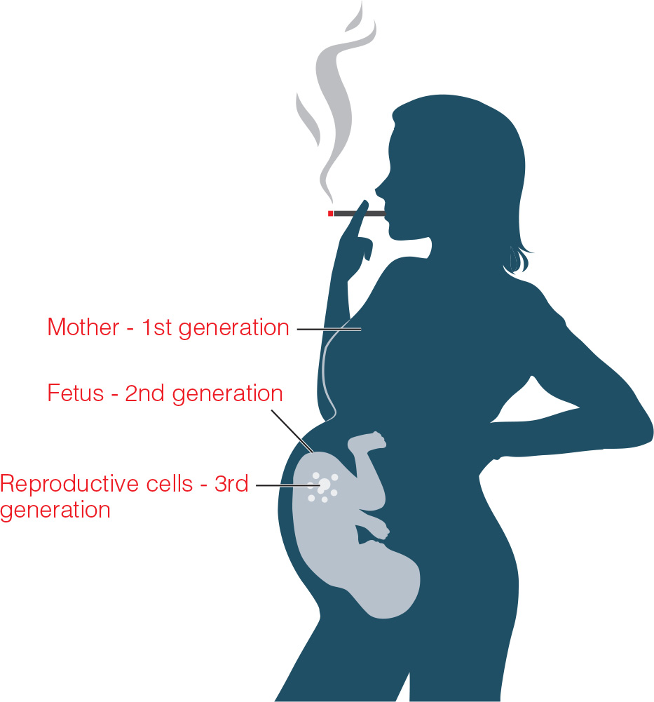
Fetal Programming
Environmental events during pregnancy may alter the expected genetic unfolding of the embryo/fetus.
Teratogen:
  Any disease, drug, or other environmental agent that can harm a developing fetus

Slide 41
Teratogens (1 of 6)
The greater and longer exposure, the more likely serious damage will occur
Susceptibility to harm influenced by genetic makeup
Effects depend on the quality of the prenatal and postnatal environments.

Slide 42
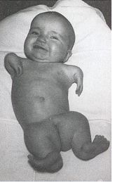
Teratogens (2 of 6)
Thalidomide:
  Used to relieve morning sickness in the 1950s
  It later became clear that there are critical periods for different deformities caused by thalidomide.
    If mother had taken thalidomide 20–22 days after conception, the baby was born without ears.
    At 22–27 days after conception, the baby often had missing or small thumbs.
    At 27 and 33 days, baby was likely to have stunted legs.
    At 35 or 36 days after conception, baby was not affected.

Slide 43
Teratogens (3 of 6)
Tobacco:
  Effects of smoking during pregnancy are varied and may include:
    Increased risk of miscarriage
    Prematurity and small size
    Respiratory problems
    Cleft lips and cleft palates
    Problems with attention and impulsivity
    Problems with delinquent behavior and substance abuse
    Raises risk of SIDS

Slide 44
Teratogens (4 of 6)
Alcohol:
  Crosses the placenta
  Disrupts the normal process of neuronal migration
  Can lead to neuronal death
  Fetal alcohol syndrome
    Noticeable physical symptoms (small head, thin upper lip, short nose, flat midface); signs of CNS damage; lower than average IQ

Slide 45
Teratogens (5 of 6)
Rubella (German measles):
  Most dangerous during first trimester
    Birth defects occur in 60–85% of babies whose mothers had disease in first 2 months of pregnancy.
  Blindness
  Deafness
  Heart defects
  Intellectual disability
Maternal diabetes:
  Risk of premature delivery
  Stillbirth or miscarriage
  Immature lung development
  Large fetal size

Slide 46
Teratogens (6 of 6)
Radiation:
  Higher-than-normal rate of intellectual disability, greater incidence of leukemia and cancers
Pollutants:
  Lower birth weight
  Preterm birth
  Impaired intellectual functioning

Slide 47
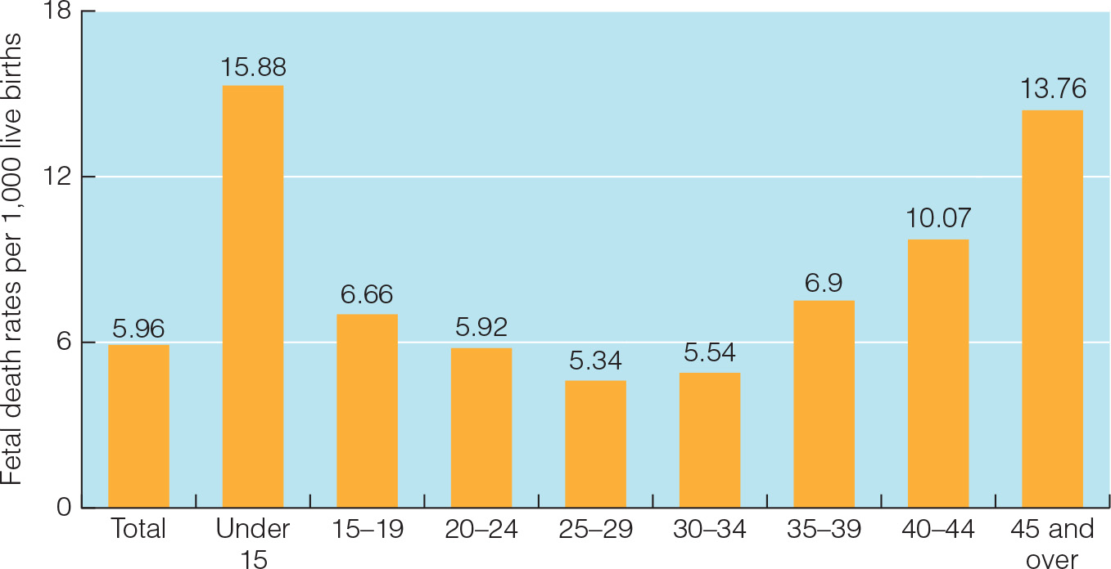
Other Factors: Maternal Age
Maternal age is a factor related to fetal death.

Slide 48
Labor
Approximately 38 - 40 weeks after conception, the mother goes into labor
As labor begins, the cervix dilatates, and the muscles of the uterus begin to contract in regular intervals

Slide 49
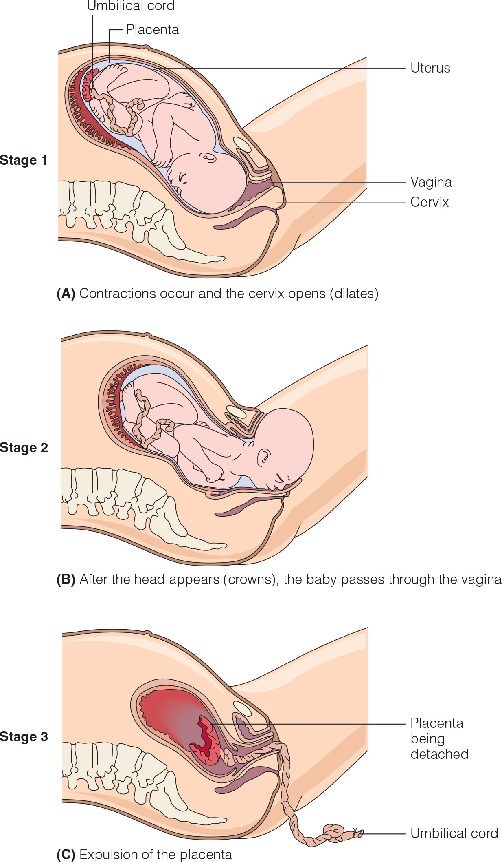
Childbirth
Childbirth is a three-stage process:
  First stage of labor: Mother experiences regular contractions.
  Second stage of labor: delivery
  Third stage of labor: delivery of the placenta

Slide 50
Possible Hazards
Anoxia:
  Oxygen shortage
    Umbilical cord becomes pinched or tangled.
    Sedatives interfere with baby’s breathing.
    Breech presentation (feet or buttocks first)
  Severe oxygen shortage
    Memory impairment
    Cerebral palsy: a neurological disability primarily associated with difficulty controlling muscle movements

Slide 51
Complicated Delivery
Cesarean section:
  A surgical procedure in which an incision is made in the mother’s abdomen and uterus so that the baby can be removed
  21% of deliveries worldwide
  32% in the United States

Slide 52
Birth Complications
Births before week 36: premature or preterm
  Low birth weight: 5.5 pounds or less
  Very low birth weight: less than 3.3 pounds
  Extremely low birth weight: less than 2.2 pounds
Premature babies develop more slowly at first, but usually catch up by 2 or 3 years of age

Slide 53
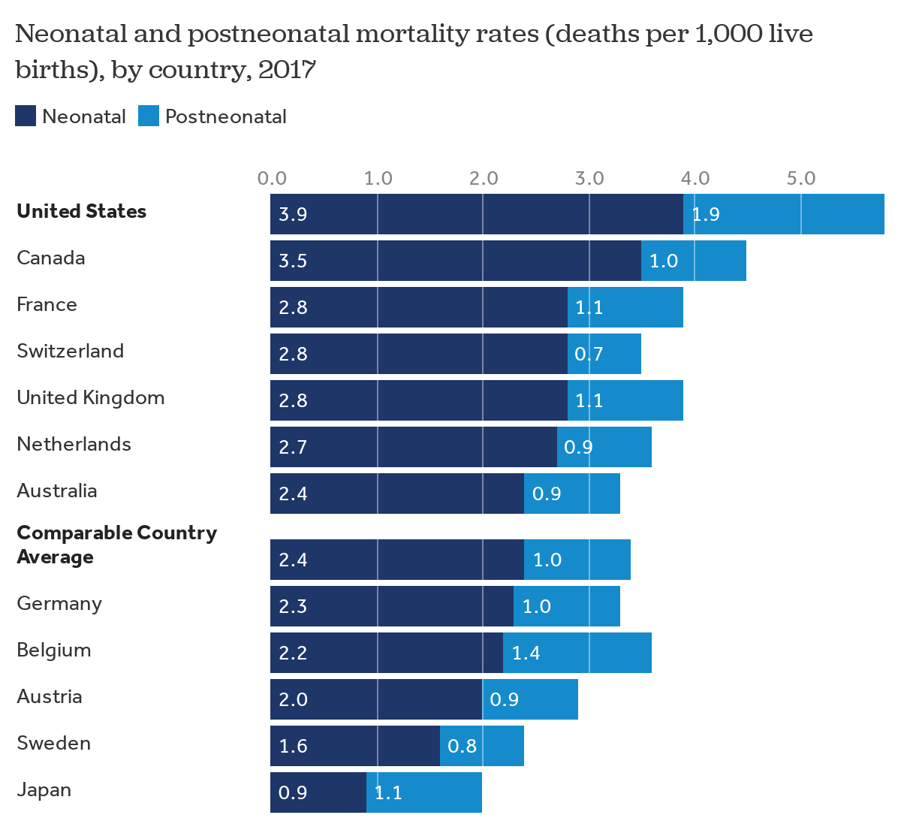
Infant Mortality
0-27 days post birth
28 days- 1 year post birth

Slide 54
Infant Mortality
U.S. mortality rate just under 1% (7 of 1,000)
  15 industrialized nations have lower infant mortality than the United States (as of 2020)
Possible factors:
  low birth weight due to lack of free or inexpensive prenatal care
  fewer paid leaves of absence for pregnant women

Slide 55
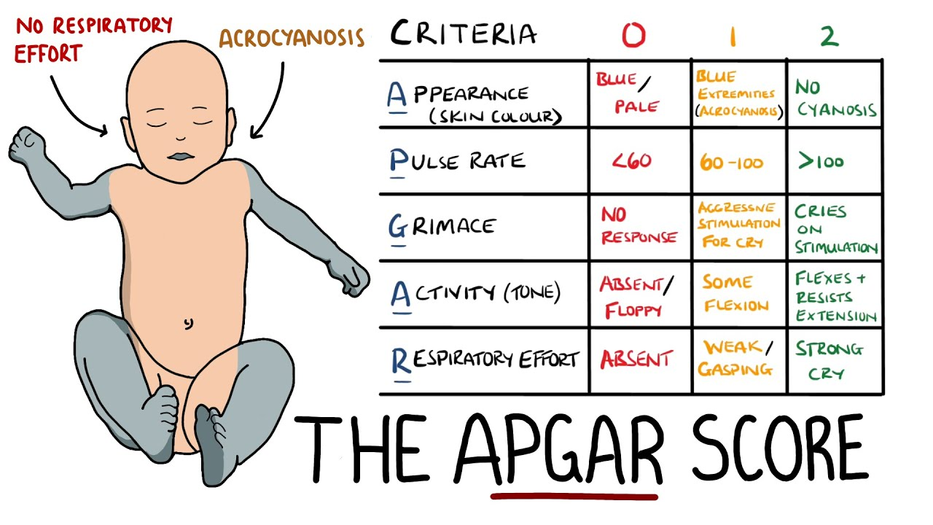
Assessing the Newborn

Slide 56
The Mother’s Experience
77% view pregnancy as positive
Postpartum depression:
  Low self-worth, irritability, disturbed sleep, poor appetite, apathy
  15–20% of new mothers
  Previous depression and lack of social support increase risk.

Slide 57
The Partner’s Experience
Becoming a father is a significant event.
  Mix of emotions during pregnancy
Some may experience physiological symptoms.
Mix of emotions during labor and delivery
Same-sex couples and heterosexual couples have similar experiences.

Slide 58
Adjustment to Parenthood
1–2 weeks after birth: 50% of new parents experience some form of negative emotion
  irritation, resentment, and crying
  reflecting on stress and physiological changes in mothers are also common

Slide 59
Adjustment to Parenthood
Months after birth: 10–15% of mothers experience postpartum depression; may affect baby
  Low self-worth, irritability, disturbed sleep, poor appetite, apathy
  Risk factors: high hormonal levels; pre-pregnancy depression, stress, lack of support
  Breast-feeding reduces risk of postpartum depression

